Slide 1
Hepatocyte
(Liver cell)
Lisosome
Distribution
*Phase II Reaction
(Conjugation)
Drug
Metabolite
CYP450
Elimination
Phase I Reaction
(e.g. Oxidation)
Conjugated Metabolite

Slide 2
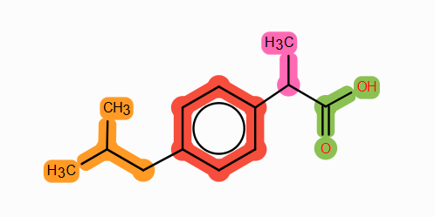
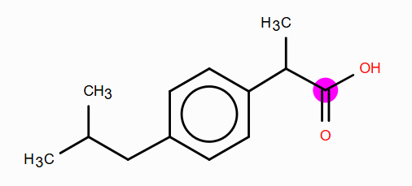
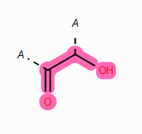
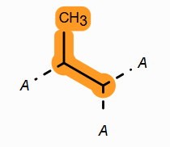
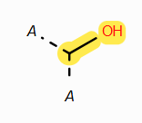
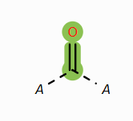
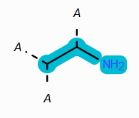
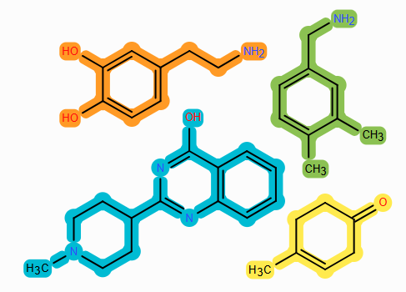


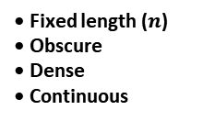




A
Chemical representation → SMILES
String encoding
CC(C)CC1=CC=C(C=C1)C(C)C(=O)O
SMILES
(linear textual representation)
Ibuprofen
B
SMILES → Morgan Fingerprints
1. Select atom
2. Check substructures in Radius = 3
• Fixed length (2048)
• Interpretable
• Sparse (Mostly 0s)
• Discrete (Integers only)
4. Hashing algorithm
…
0
0
0
0
4
0
0
1
0
0
1
0
0
0
0
0
…
3. Iterative process for each atom
ECFP6 = […, 0, 0, 0, 0, 4, 0, 0, 1, 0, 0, 1, 0, 0, 0, 0, 0, ...]
C
SMILES → Neural Embedding
Dim 2
$$ℝ^{k}$$
Representation learning
Embedder
$$f_{θ}$$
$$z= f_{θ}\left(x\right)$$
$${z ϵ ℝ}^{k}$$
$$z=[1.12, 0.33, −1.34, …,n]$$
Feature extraction
• Fixed length ($n$)
• Obscure
• Dense
• Continuous
Dim 1
$$x=e\left(t_{1}\right), e\left(t_{2}\right), … , e\left(t_{n}\right)$$
Ibuprofen
Dim 3
Large chemical db
Ibuprofen SMILES
Learned molecular embedding space ($k$-dimensional)
Notes:
Z = final embedding
E(t1) is the tokenization step, with the learned tokenizer
fO is the embedder
X is the matrix resulting form the tokenizer step of introducing the ibuprofen SMILES

Slide 3
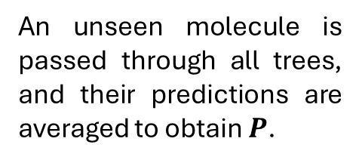
A
 | X _{j = 1} | X _{j = 2} | X _{j = 3} | X _{j = 4} | X _{j = p}
X_{i =1} | 1.23 | 0.77 | 0.88 | 0 | …
X_{i =2} | 0.12 | -0.52 | 1.00 | 1 | …
X_{i =3} | 0.31 | 1.11 | 0.59 | 0 | …
X_{i = n} | … | … | ... | … | …
Training set
(n molecules, p features)
Features
Molecules
1. Bootstrapping
Random molecule and feature selection for tree construction.
B
K trees grown in parallel
Decision tree 1
Decision tree 2
Decision tree 3
2. Multiple tree construction
Each tree uses a different bootstrapped sample to partition molecules via decision nodes.
X _{j} ≥ 0.2
X _{j} < 0.2
X _{j} > 0
X _{j} ≤ 0
X _{j} = 0
X _{j} ≠ 0
-
+
-
+
-
+
K trees
…
1
3
5
2
6
7
1
3
8
2
4
7
3
5
8
2
4
9
C
X_{new} predicted independently
X_{new}
…
3. Aggregation
f₁
= 0
f₂
= 1
f₃
= 1
An unseen molecule is passed through all trees, and their predictions are averaged to obtain $P$.
$$\frac{1+0+1 +…}{K}=0.66=P$$
(Average probability)
If aggregated P > threshold* then is predicted to be metabolized by CYP_{XYZ}
X_{new}

Slide 4




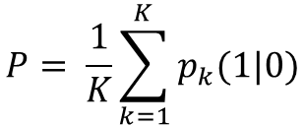



Random Forest
(Many deep trees, built in parallel from Bootstrap simples)
Each tree greedily reduces Gini impurity → Pure nodes
XGBoost
(Trees built sequentially on whole dataset, errors forwarded with increased weights)
Tree_{k = 1}
$$X_{j} ≤ θ_{j}$$
Tree_{k = 1}
$$X_{j} ≤ θ_{j}$$
$$X_{j} ≤ θ_{j}$$
$$X_{j} ≤ θ_{j}$$
1
$$X_{j} ≤ θ_{j}$$
1
0
0
$$X_{j} ≤ θ_{j}$$
0
1
0
0
$$X_{j} ≤ θ_{j}$$
1
0
Tree_{k = 2}
1
1
0
0
Increased weight of missclassified samples
Next tree trained on re-weighted samples
Pure nodes reduce Gini impurity values
0
1
0
K trees built in parallel and aggregated
Process repeated until K trees are built
1
0
$$P= \frac{1}{K}\sum_{k=1}^{K}{p_{k}(1|0)}$$

